Slide 1
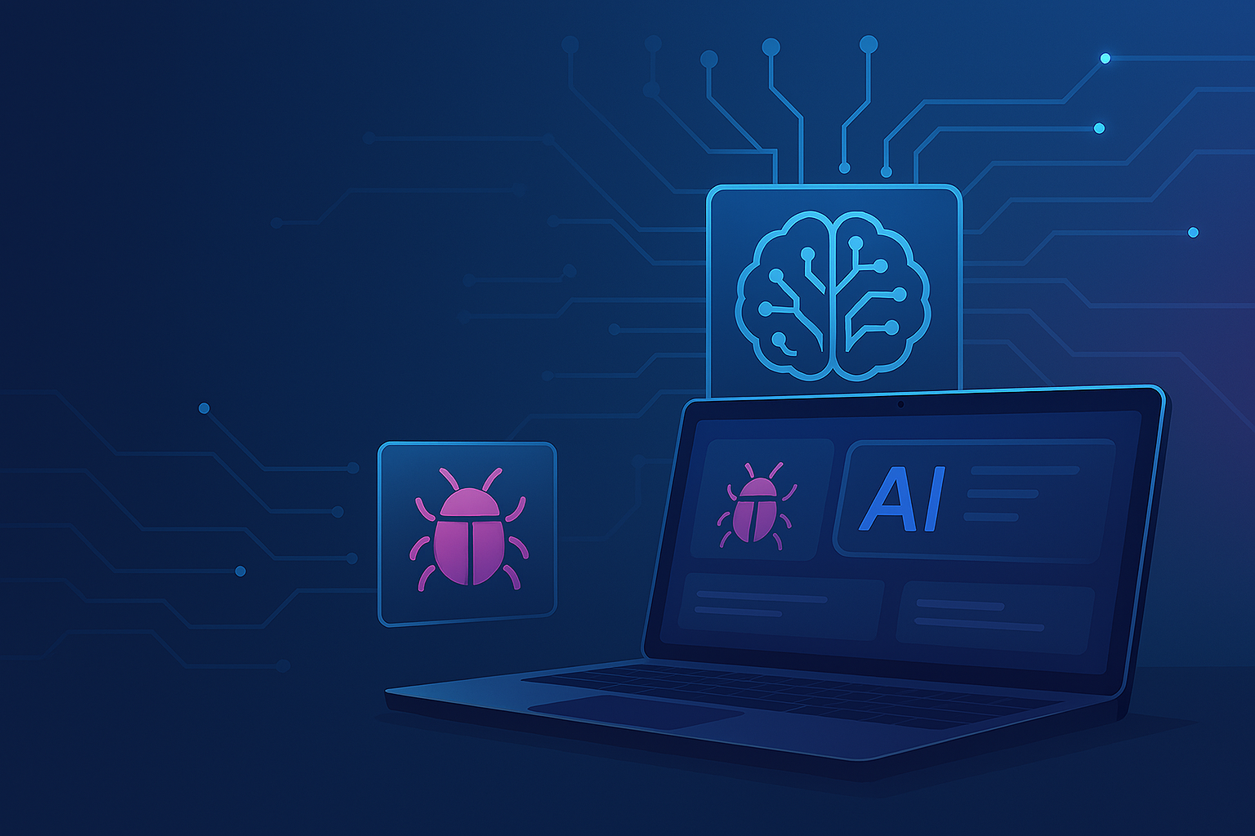
AI-Enhanced Bug Tracking Platform
Full-stack solution with React, Spring Boot, FastAPI & AI RAG integration
Divya sri vemula

Slide 2



The Problem & Our Solution
The Problem
Our Solution
Bug tracking is manual, repetitive, and lacks context. Developers waste valuable time:
An intelligent bug tracker that uses AI to augment the developer workflow. It provides:
•
Shifting through duplicate issues.
•
Smart suggestions for priority and resolution.
•
Manually prioritizing new tickets.
•
Real-time retrieval of similar, resolved issues.
•
Searching for resolutions to similar past bugs.
•
A smarter, context-aware bug creation process.

Slide 3
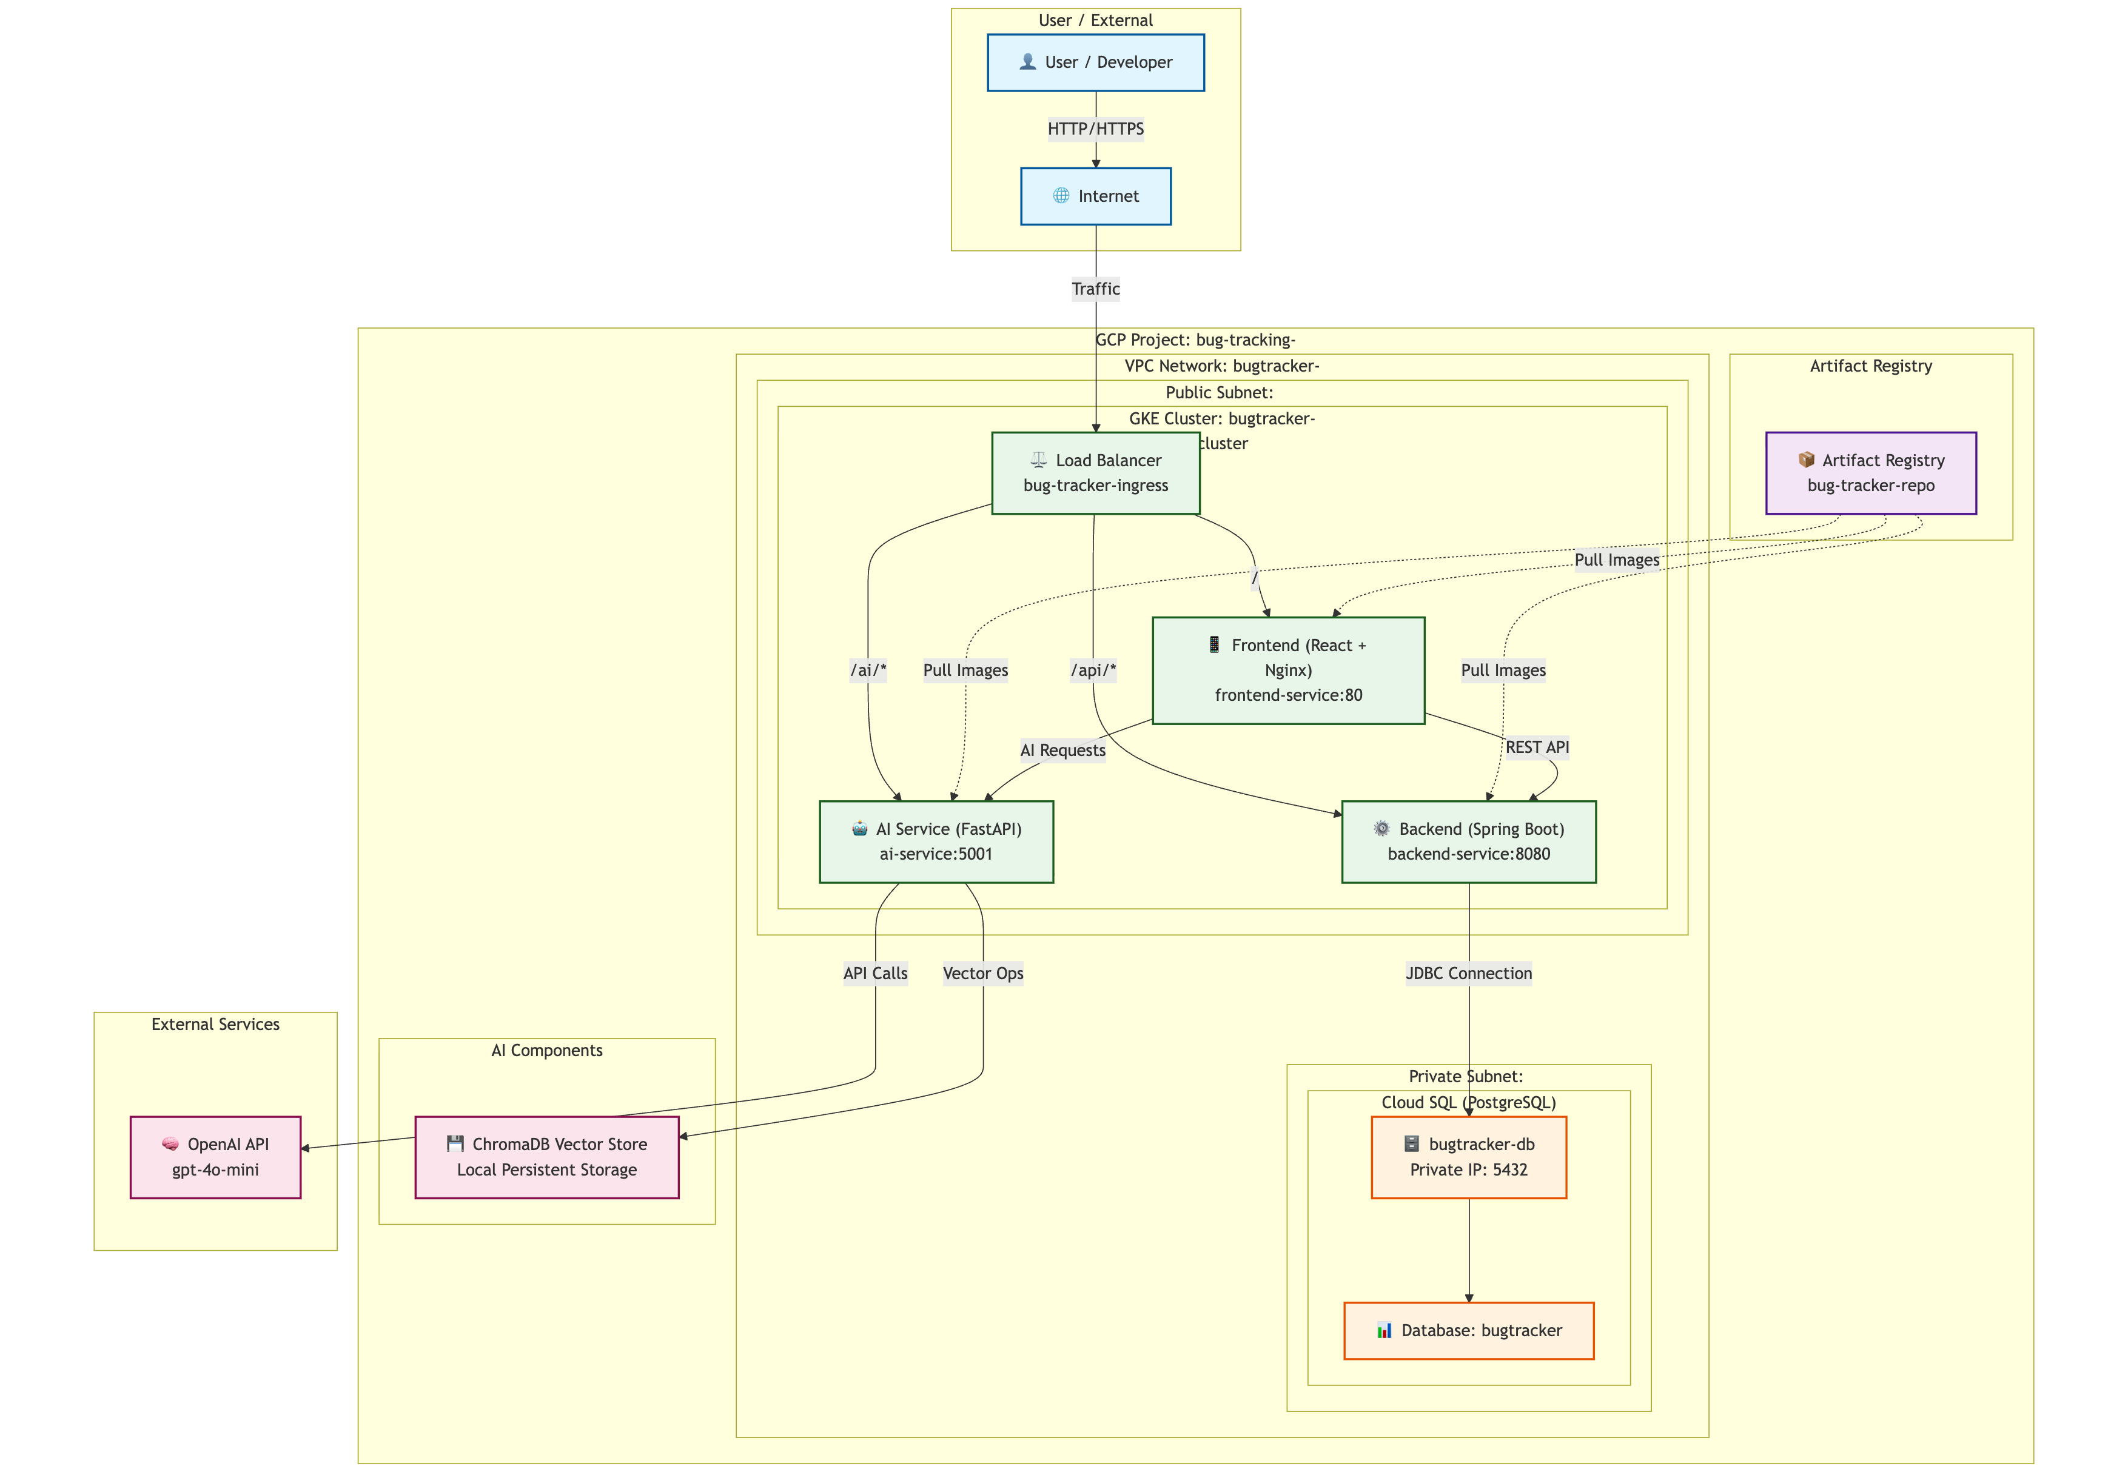
Full-Stack System Architecture

Slide 4
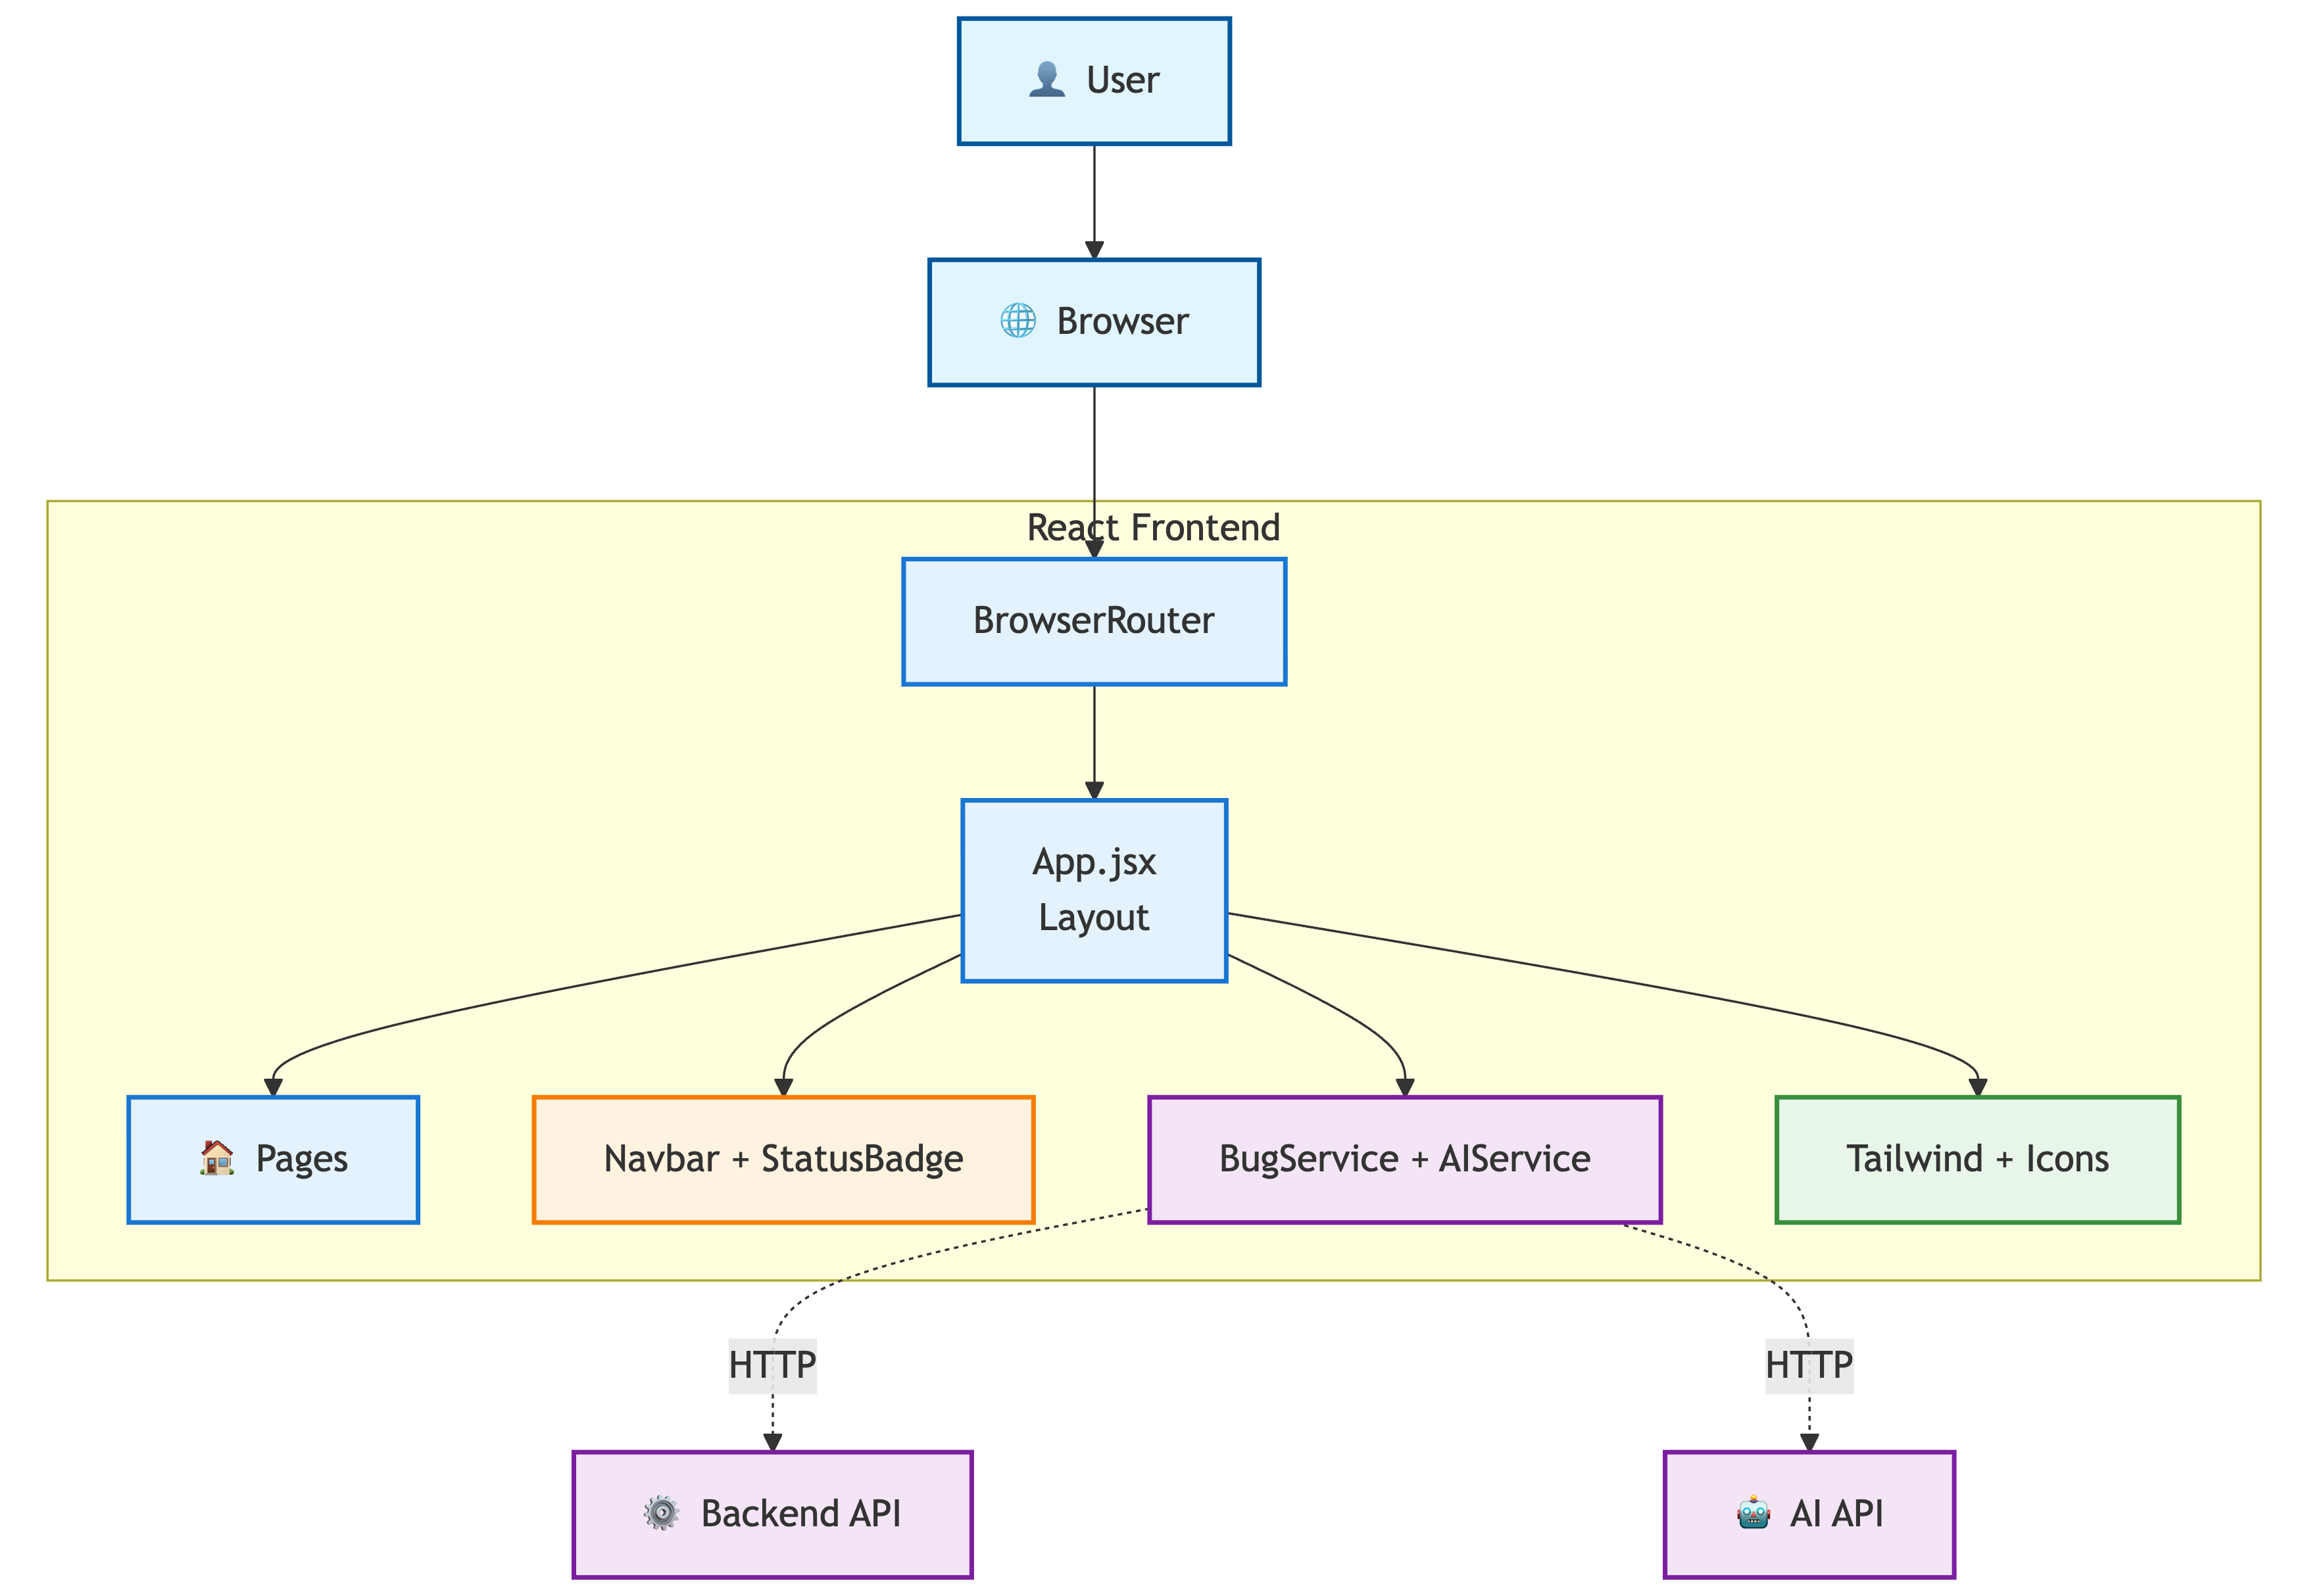

The Frontend: Built with React

Slide 5
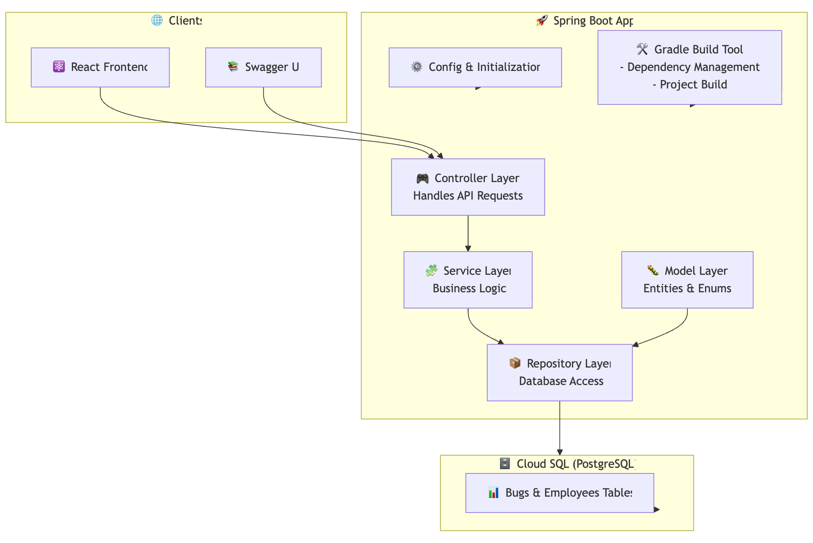
The Backend: Built with Spring Boot

Slide 6
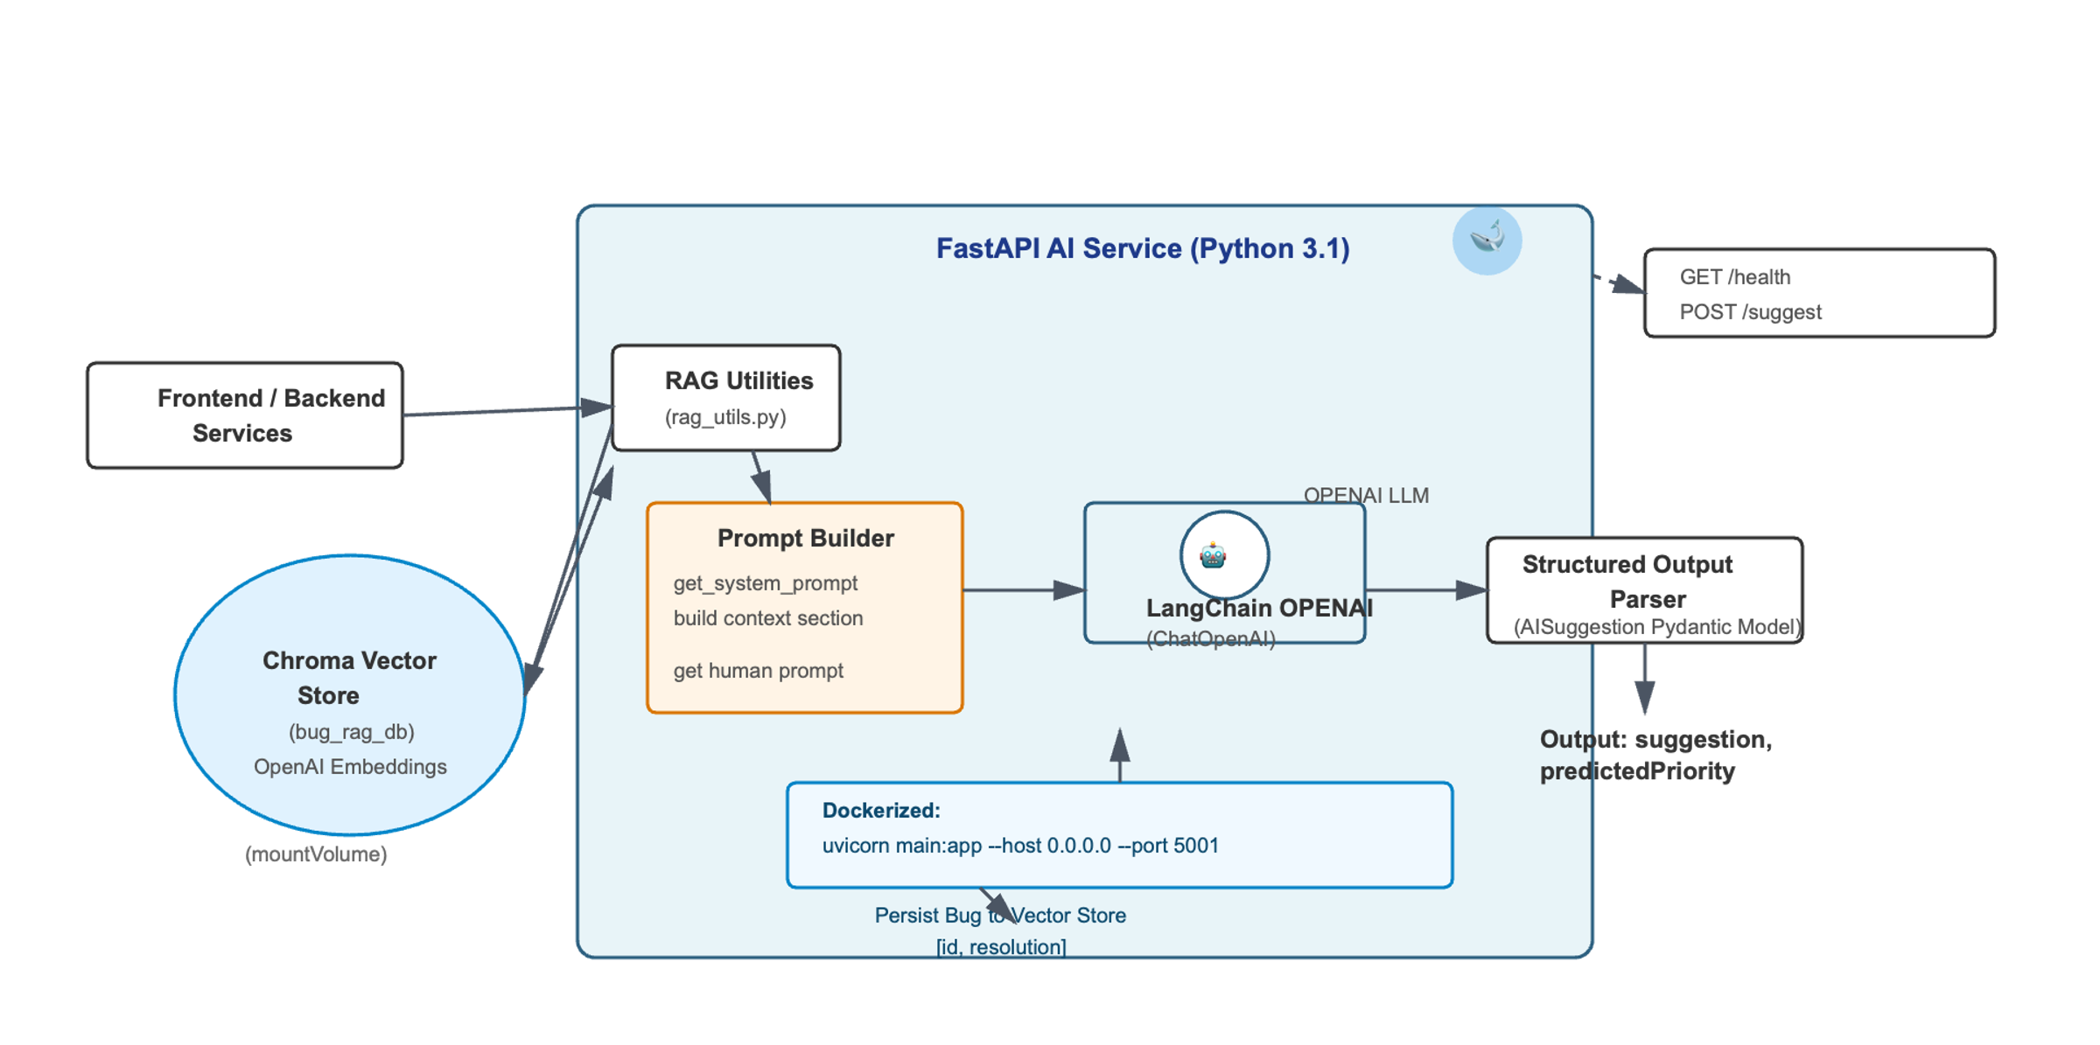
The "Magic": AI Service (FastAPI)

Slide 7
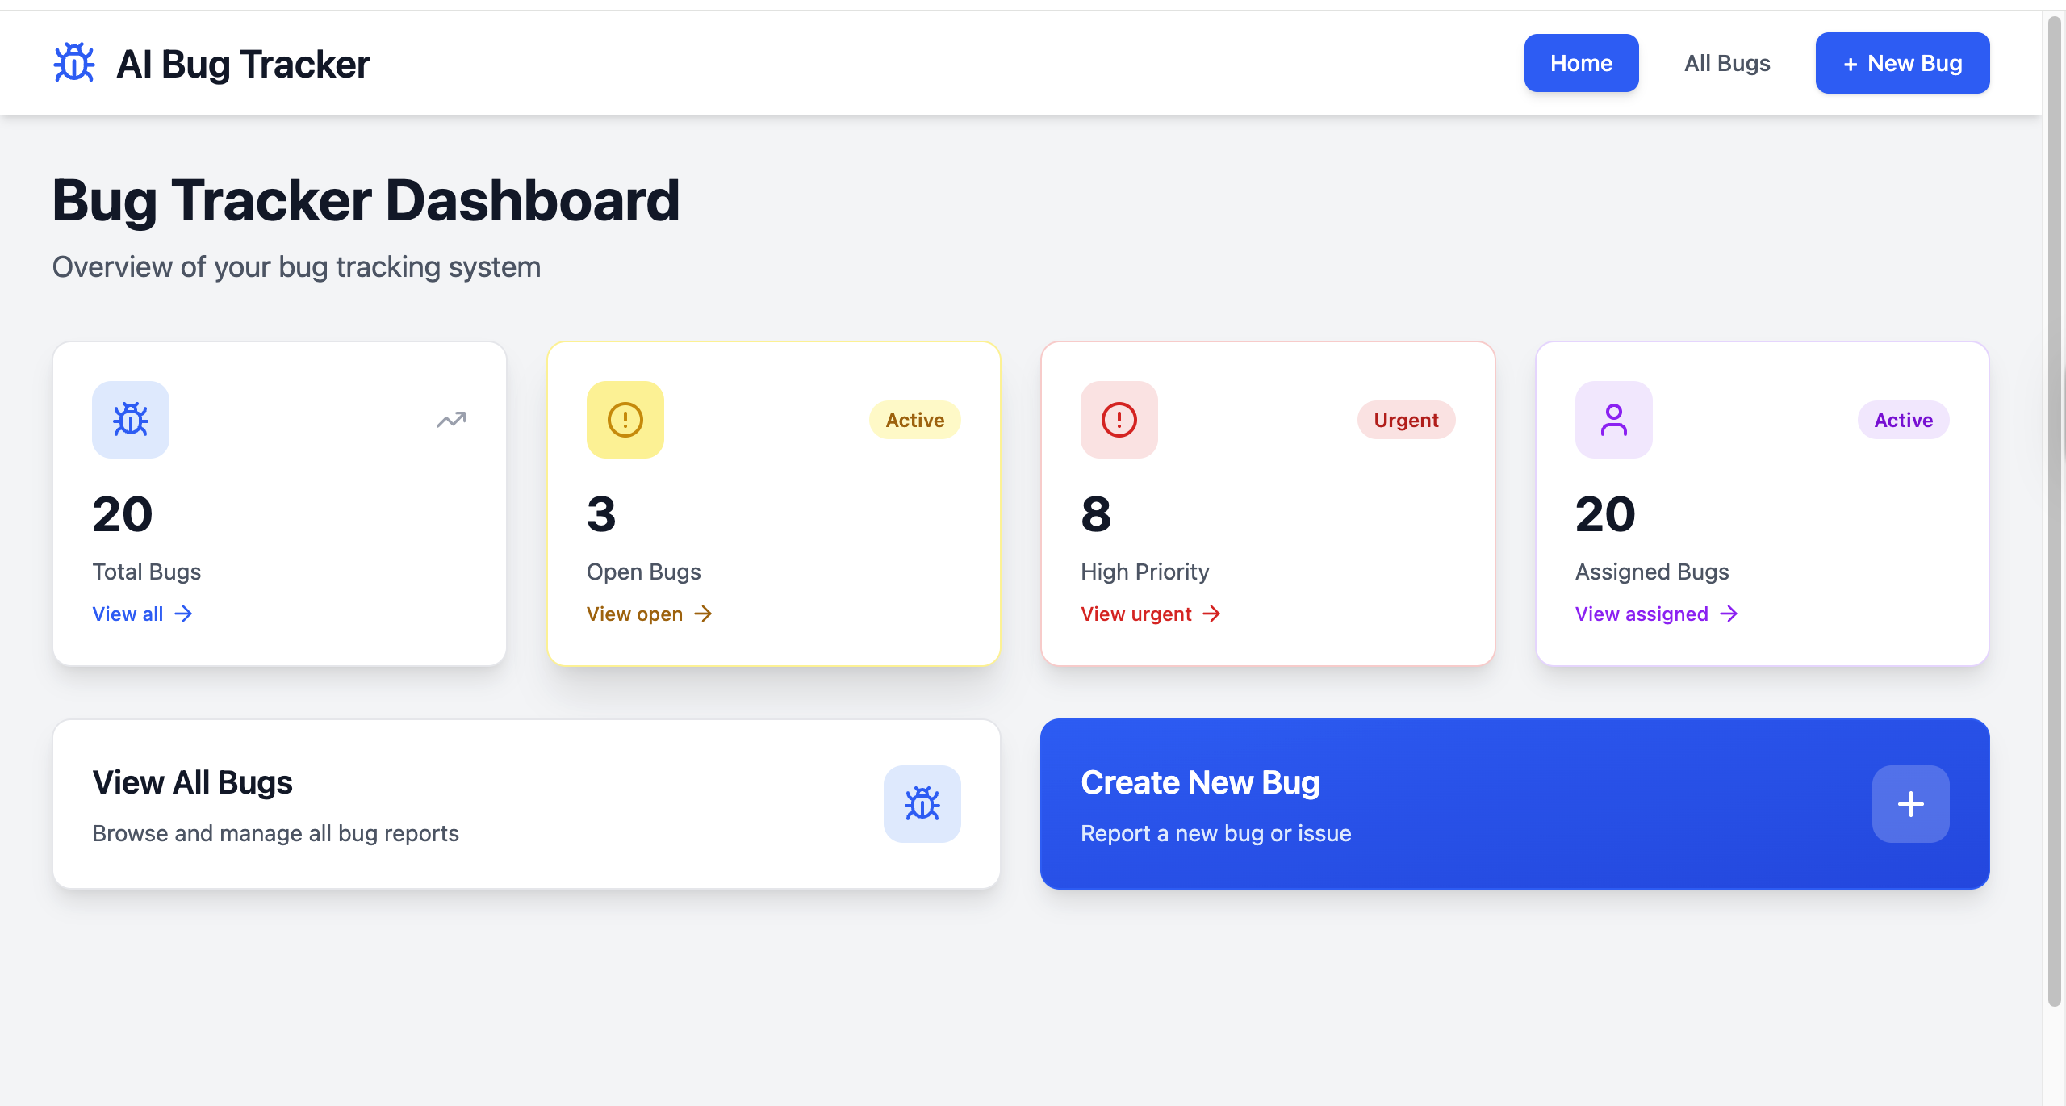
Application in Action

Slide 8
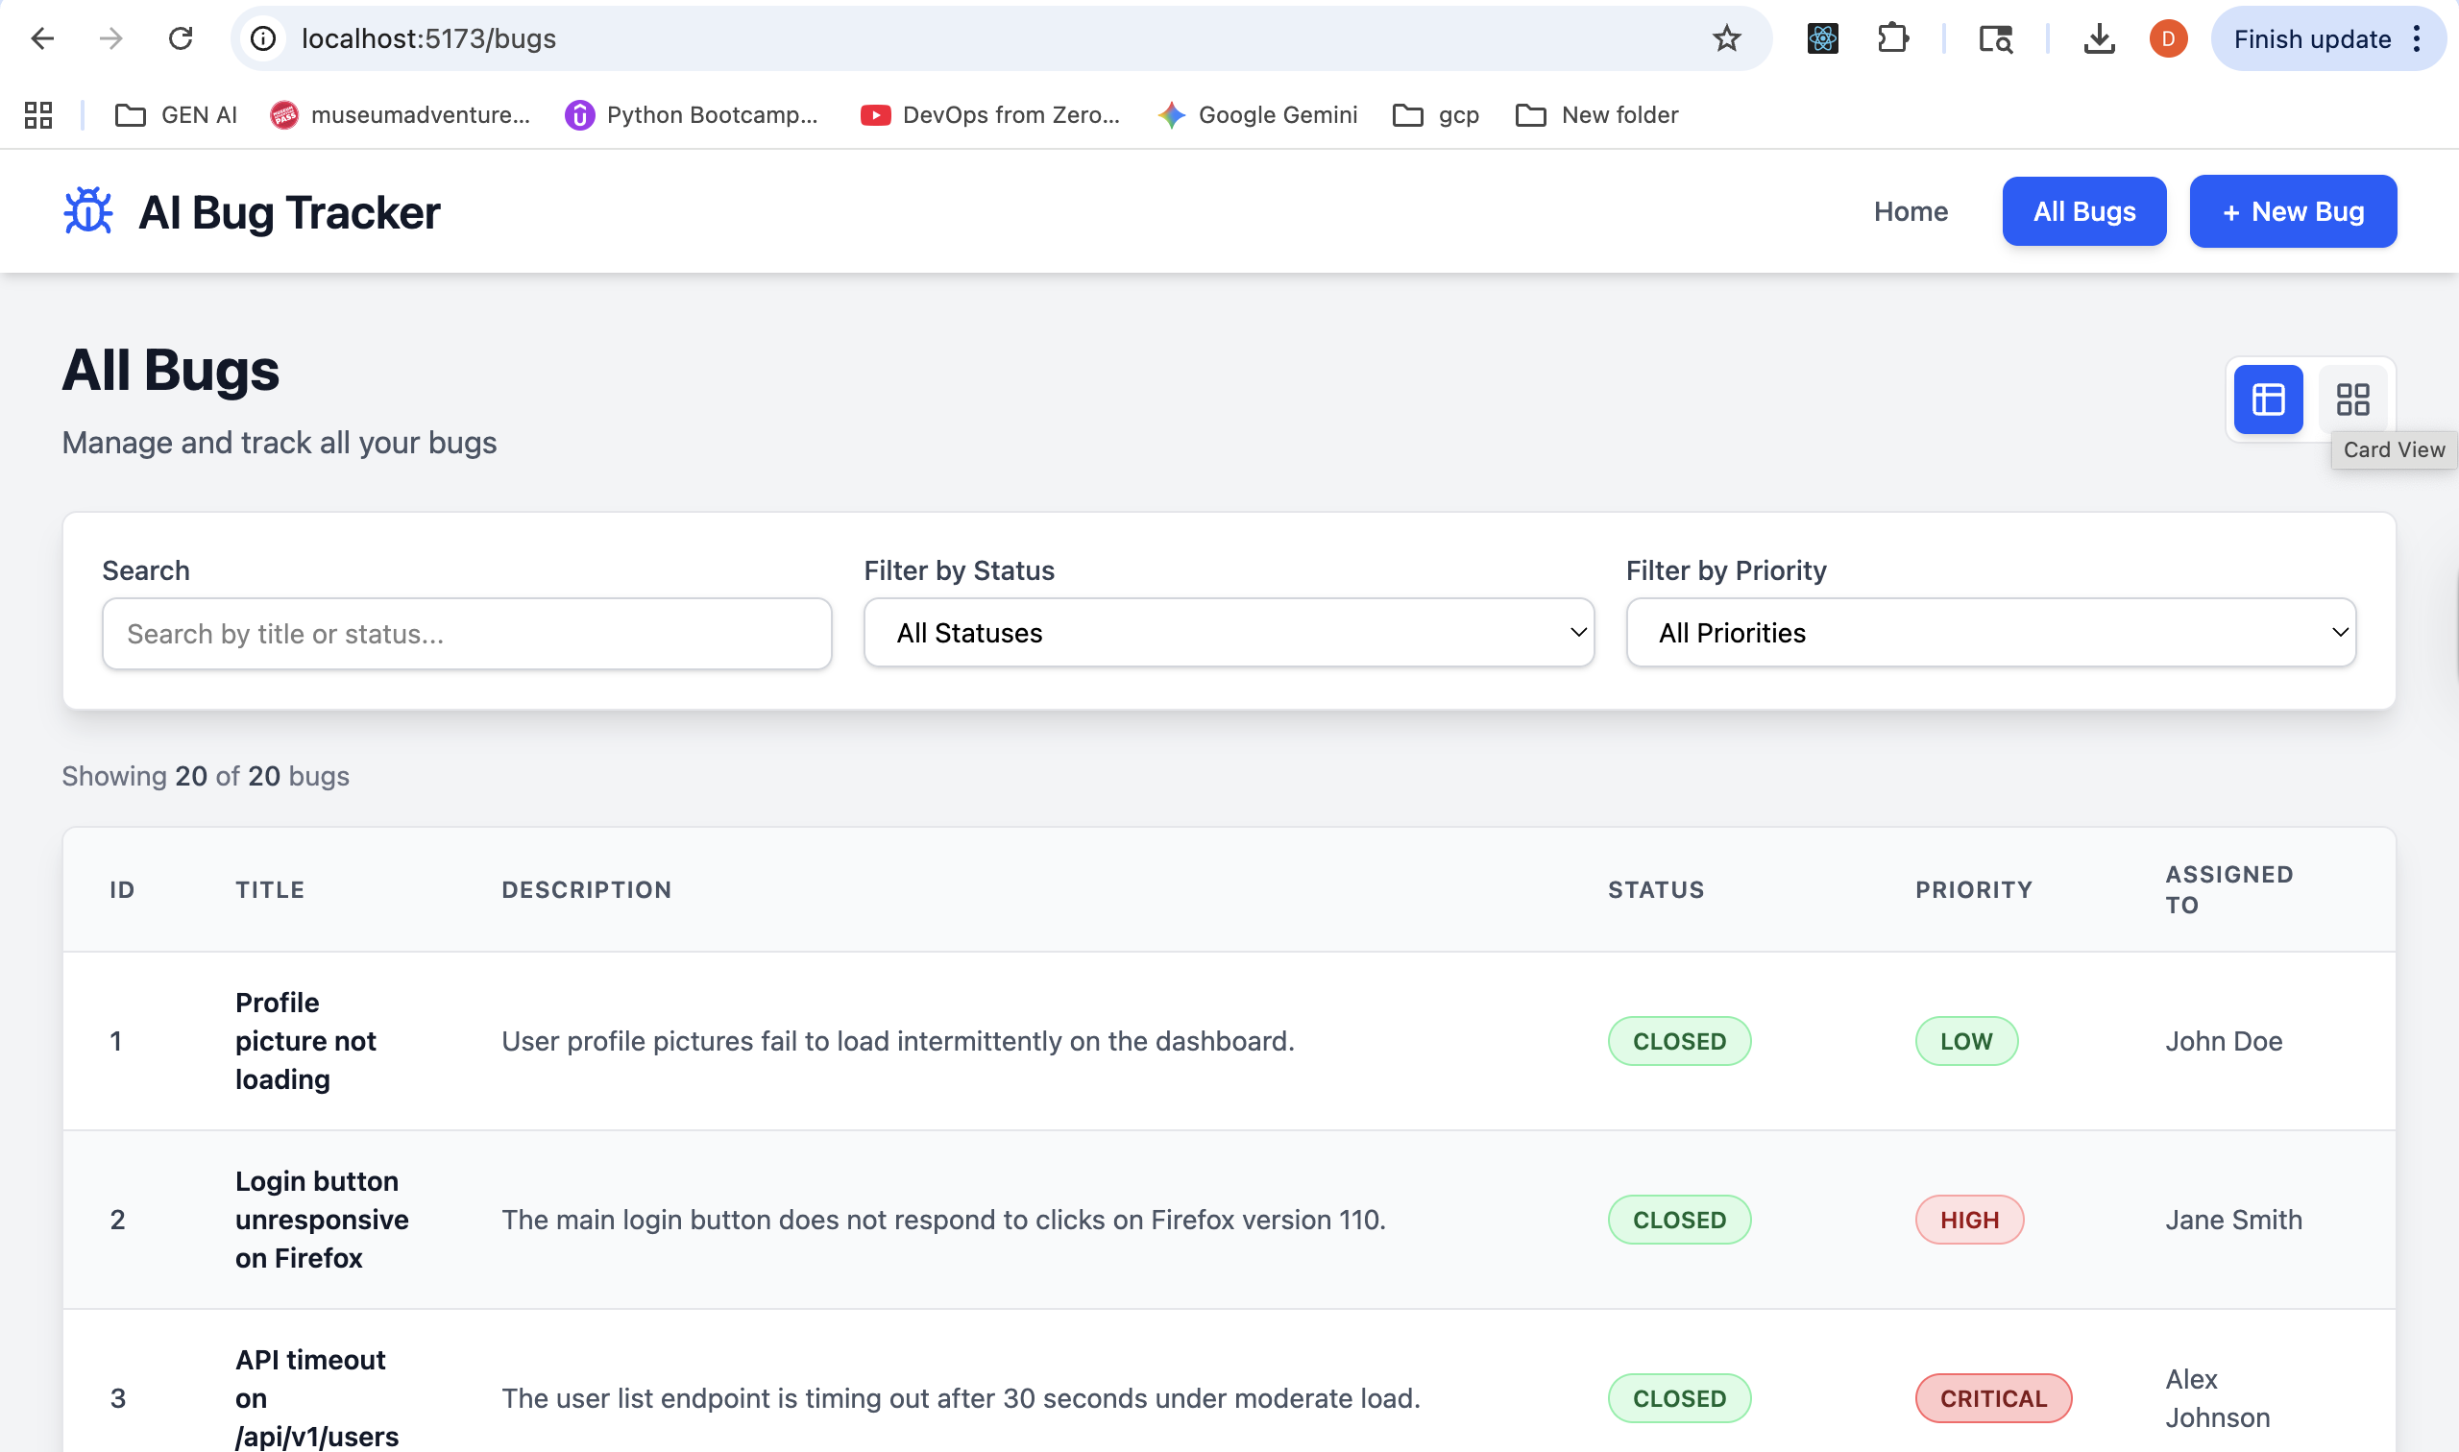
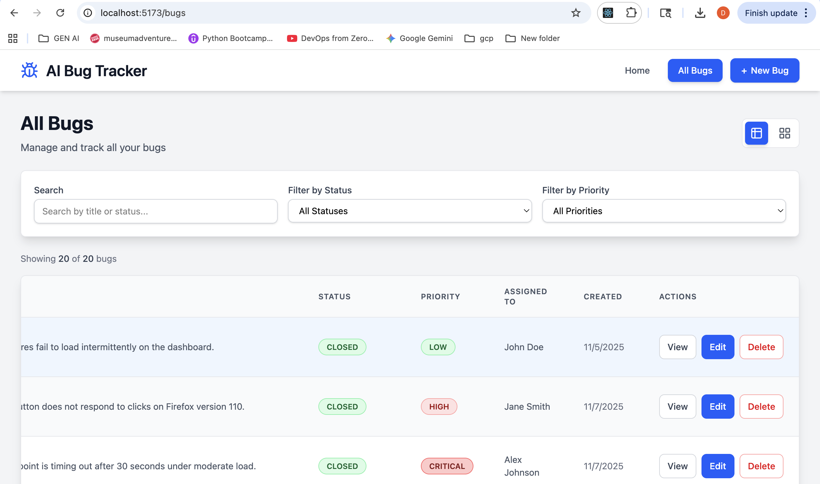
Application in Action

Slide 9
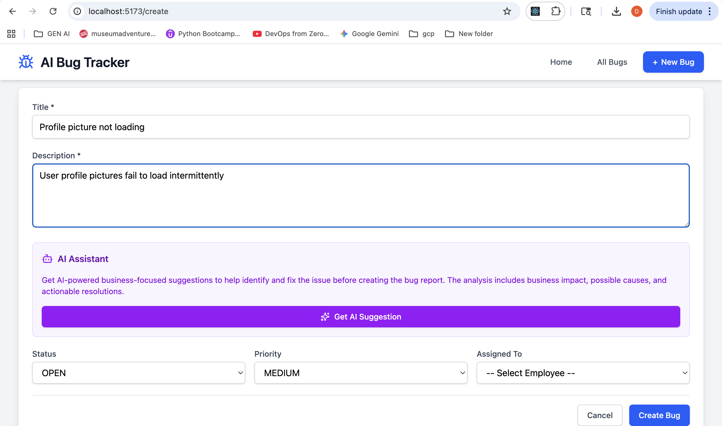
Application in Action

Slide 10
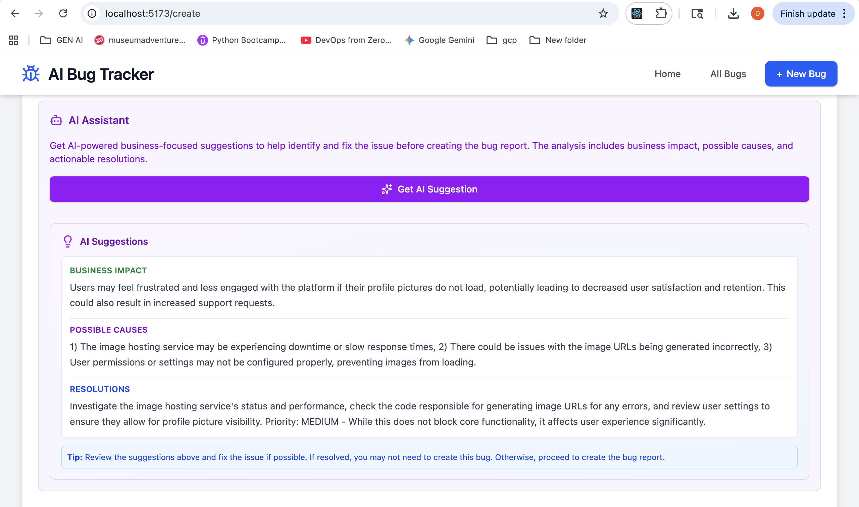
Application in Action

Slide 11
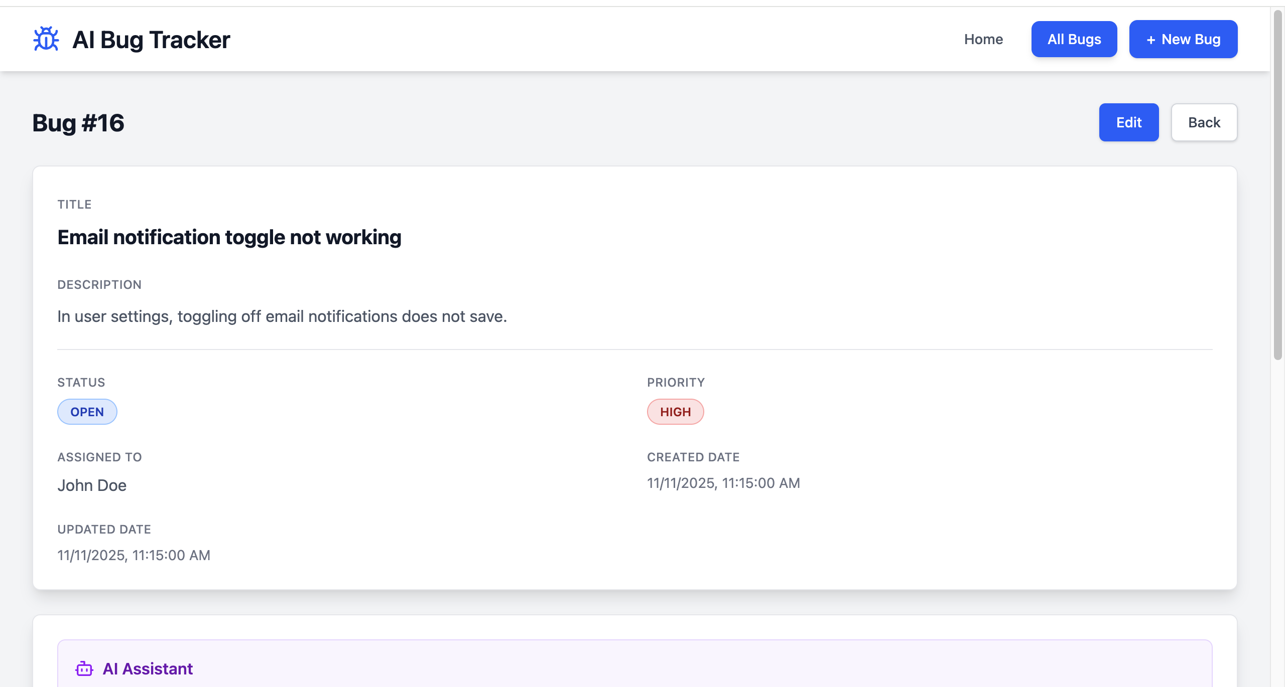
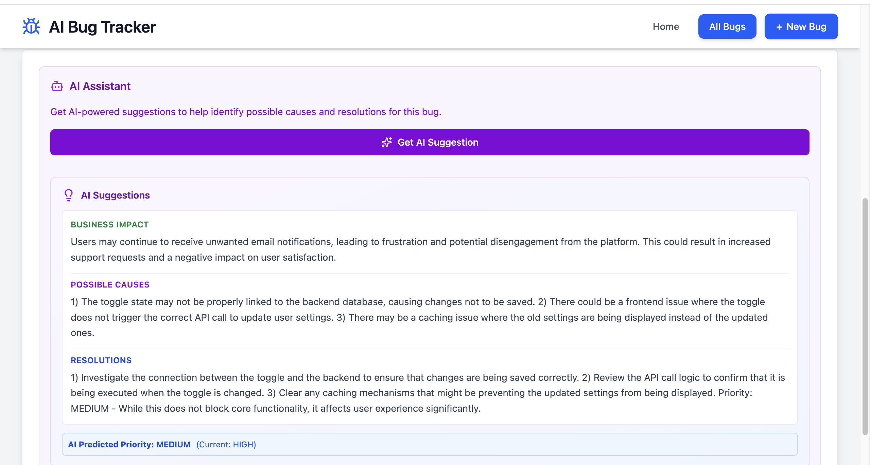
Application in Action

Slide 12

🧱 Infrastructure Setup
Terraform Scripts used to automate provisioning of:
Compute resources for backend & AI services
Secure networking and IAM configurations
Cloud SQL (PostgreSQL)
Containerization & Deployment
Application containerized using Docker
Deployed via Kubernetes YAML files for:
Pod configuration & scaling
Service exposure and ingress
Resource limits and health checks
☸️ Containerization & Deployment
Application containerized using Docker
Deployed via Kubernetes YAML files for:
Pod configuration & scaling
Service exposure and ingress
Resource limits and health checks

Slide 13
Questions?
Thank you for your time.

